Slide 1
Designing an ACT Smartphone App: “Smart Quit” Case Study
Jonathan B. Bricker, PhD
Public Health Sciences, Fred Hutchinson Cancer Research Center
Psychology Department, University of Washington, Seattle, WA

Slide 2
Acknowledgments
Katrina Akioka, BS, Project Manager, FHCRC
Jessica Harris, MA, Research Therapist, FHCRC
Jaimee Heffner, PhD, Psychologist, FHCRC
Julie Kientz, PhD, Computer Scientist, UW
Brandon Masterson, CEO, 2 Morrow Inc.
Jo Masterson, COO, 2 Morrow Inc.
Laina Mercer, MS, Statistician, FHCRC
Roger Villardaga, PhD, Psychologist, UW
Nutrition Assessment Shared Resource, FHCRC
Hartwell Innovation Fund, FHCRC

Slide 3
Let’s Take a Journey

Slide 4
The Journey Ahead
Current status of smartphone apps
ACT: challenges for smartphone delivery & how we addressed them
Design process of our ACT “Smart Quit” smartphone intervention
Lessons learned and conclusions

Slide 5
mHealth Smartphone Apps
44 million downloads in 2012 and 142 million expected in 2016 (Juniper Research, 2012)
Low cost, real time ways to assess and change behavior
Need to evaluate these new technologies for their efficacy (Francis Collins, NIH Director, 2012)

Slide 6
ACT Has Smartphone Potential
Contextual: Internal and external cues can trigger the behavior and its intervention.
Experiential: Contextually-cued exercises that are self-focused.
Metaphorical: Phones can tell stories relevant to the problem.

Slide 7
Challenge #1: How to Distill ACT?
Acceptance: Counterintuitive.
Values: Hard for people to name and connect to the specific behavior to change.
Metaphors: Hard to see their relevance to specific behavior. Literal thinkers.
Skills Exercises: Counterintuitive. Skills learning is not expected or desired for many behavior changes.

Slide 8
Challenge #2: How to Distill ACT By Phone?
Engagement: Biggest problem. Majority will never open app or only open once. No practice.
Confusion: “Huh?” App-only leaves users scratch their heads on counterintuitive concepts.

Slide 9
Addressing Challenge #1: How We Distilled ACT
Main principle: “Show. Don’t tell.” (Hemmingway, Death in the Afternoon).
Acceptance: Showed them exercises.
Values: Testimonials. Shared “inspiring stories.”
Metaphors: Vivid. Simple. Behavior examples.
Skills Exercises: Vivid. Simple. Quick. Relevant.

Slide 10
Addressing Challenge #2: How We Distill ACT By Phone
Engagement: Push notifications. Pull for when needed. Quick practices. Tracking. Reinforcement via Rewards, Progress Indicators, and Sharing.
Confusion: Few words. Simple explanations. Simple navigation.

Slide 11
Smart Quit: Intervention Goals
Increase Engagement: Opening the app, viewing ACT exercises, and duration.
Determine Whether Engagement Predicts Behavior Change: To enhance future versions.
Increase Behavior Change: Change attempts and decreases in the behavior.

Slide 12
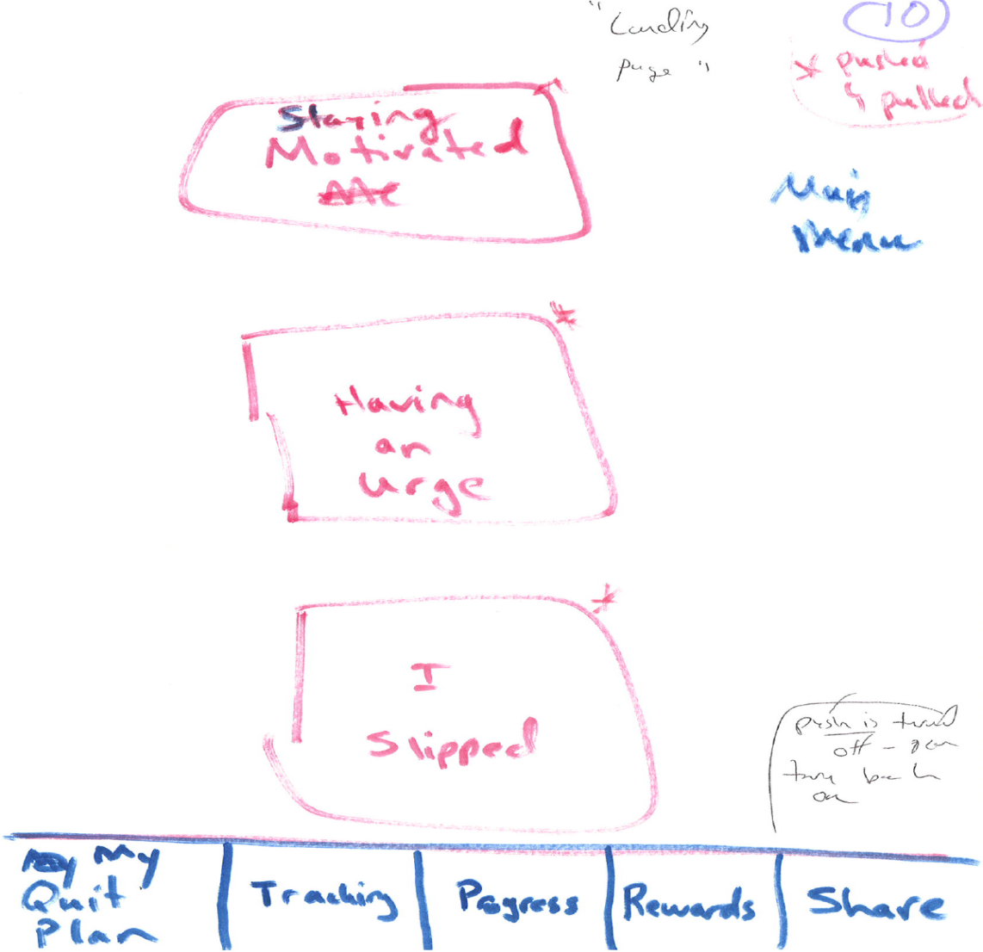
Story Boarding: Draw a Picture

Slide 13
Linking Smoking to Hexaflex: Chose Key Targets
Staying Motivated: Values & Action
Having An Urge: Acceptance (Willingness, Defusion, Self-As-Context)
Slips/Lapses: Acceptance (Compassion)

Slide 14
Linking Smoking to Behavior Shaping: Reinforcements
Progress: View progress in tracked smoking, acceptance, practice of exercises
Rewards: Badges earned for proximal behaviors (e.g., opening the app)
Sharing: Inner Circle, Email, Facebook, Twitter

Slide 15
Splash
Intro and How to Use App
Set up of
My Quit Plan
Overview of App Structure
Main Menu
Once My Quit Plan is set up, app will always open to Main Menu
Main
Tracking
My Quit Plan
Progress
Sharing
Staying Motivated
Reports
Having an Urge
Locations
I Slipped
Badges
Notes:
2MM Notes:
Slide #5 will go back to first page of my Quit Plan
Slide 31 – sharing – will use default sharing central set up
FHCRC Notes: Updated slide deck. Tracking moved to the front of row.

Slide 16
Usability Testing Revisions
Six Rounds of Testing: 4 internal/2 external
Identified 150 Total Revisions
Primary Revisions:
Logic/Flow Errors (e.g., buttons lead to wrong screen)
Content Changes (e.g., text too wordy)
Aesthetics (e.g., fonts too small/bad colors)

Slide 17
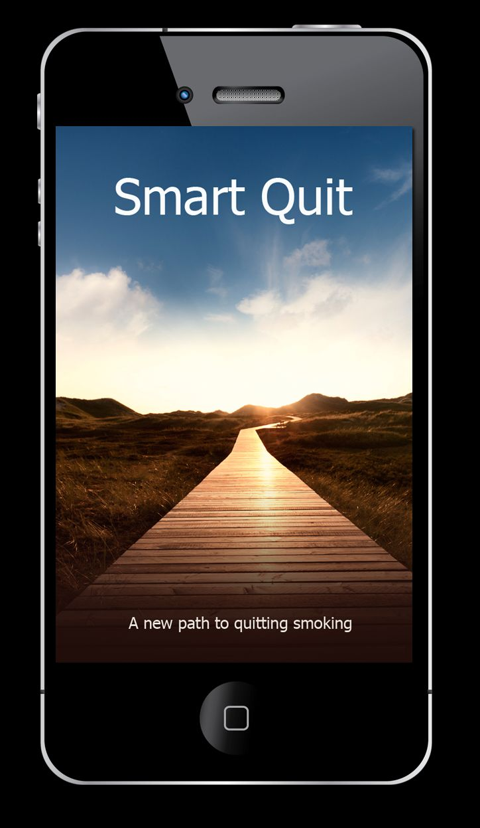
Notes:
Jonathan B. Bricker, PhD
jbricker@u.washington.edu
1/17/2008
17

Slide 18
Intro Screen: Car Journey

Slide 19
Lessons Learned
Keep it short: Exercises need to be about 30 to 60 seconds.
Make it clear: Metaphors need specific links to the problem behavior.
Guide the user: Step-by-step instructions on daily use.

Slide 20
Conclusions
ACT has great smartphone potential.
Follow user-centered design principles.
Test the app.
We hope the best is yet to come.

Slide 21
Many Thanks!
Contact: Dr. Jonathan Bricker
Email: jbricker@uw.edu
Notes:
Jonathan B. Bricker, PhD
jbricker@u.washington.edu
1/17/2008
21

